Slide 1




3rd Meeting
Expert Working Group on Floods
(Ulcinj, Montenegro)
Road Map for the Development of the Drin’s Basin Flood Policies (FRM-S & FRM-AP)
October 2023

Slide 2
Table of Contents
Key International Principles on FRM (General Framework)
Review of Existing FRM Policy Framework (Enablers & Barriers for efficient transboundary FR Management)
Axes of Action for the Proposed Transboundary Drin FRM Strategy
Conceptual & Methodological Approach for the Development of a FRM Strategy & Action Plan
Draft Road Map - Operational Phases
Draft Road Map - Time Scheduling
Proposed Flood Risk Areas of Mutual Concern* (Next Presentation)
Remarks

Slide 3
International Development & Climate Resilience Agenda
WATER is the common element interconnecting the 3 major global milestones in the International Development & Climate Resilience Agenda with the National Development Plans:
  UN-FCCC Paris Agreement
  UN-Sustainable Development Goals (SDGs)
  UN-DRR - Sendai Framework for Disaster Risk Reduction
UN-FCCC Paris Agreement
  Climate Action Pathway – WATER: By investing in the resilience of our water resources & ecosystem services, we can reduce climate risks to people, ecosystems, & economies
Sendai Framework for Disaster Risk Reduction (DRR)
  Floods and Droughts should be seen as two sides of the same coin and addressed together. Countries shall strengthen Disaster Risk Governance to manage disaster risk, investing in disaster risk reduction for resilience, and enhancing disaster preparedness for effective response
UN-Sustainable Development Goals (SDGs)
  There are 25 targets related to Disaster Risk Reduction (DRR) in 10 of the 17 SDGs - Sustainable Development Goals firmly establishing the role of DDR as a core development strategy.

Slide 4
Key International Principles in FRM
Integrated Flood Risk Management (IFRM)
  Holistic Water Resources planning approach that stresses the interrelationship between socioeconomic development, environmental sustainability, and FRM.
  The IFRM approach implies integrated Land & Water resources management in a river basin, including Groundwater (Transb. Aquifer), Coastal areas (Source to Sea approach), Agriculture (Food Security), and Urban areas (Urban Water Management)
EU Floods Directive (2007/60/EC)
  Member States shall establish flood risk management FRM plans coordinated at the level of the river basin district. Plus WFD 2000/60 & GWD 2006/118EC (Transb Aquifer)
  Where an international river basin district extends beyond the boundaries of the Community, Member States shall endeavor to produce one single international flood risk management plan, or a set of flood risk management plans coordinated at the level of the international river basin district (Art. 8).
Linking Water to Climate Change
  Linking the FRM strategy to the National Climate Policy (NAPs - National Adaptation Plans) or other national policies can facilitate its linkage to a variety of public and private investment agendas (Watering the NAPs and NDCs)

Slide 5
Review of Existing FRM Policy Framework
ENABLERS:
  The extensive work done in the last 20 years, the high-level results achieved (implementation of EU FD + Legislation Harmonization), and the willingness of the riparian countries to continue collaborating jointly constitute the most valuable resource (foundations) to build the Drin FRM Strategy. Although this, there are several areas that need to be strengthened to warrant an efficient transboundary FRM.
BARRIERS: (Excluding Further Technical Required Assessments)
  Institutional Weaknesses: The achievement of the MoU Shared Vision needs a paradigm shift from traditional FRM to IFRM at the basin-wide level, breaking the silos of single agencies addressing isolated parts of the FRM process (Joined-Up Governance)
  Sub-Financing of Key Institutions Related to Floods: The linking of the FRM Strategy to the NAPs will favor a greater presence of the hydro-climatic hazards in the national planning process and the access to new public and private investment agendas.
  Lack of a Legally Binding Transboundary Management Body: Drin CORDA was enough to promote a transboundary dialogue, define a common vision, and provide political support to a set of projects and initiatives, this organization however is not suitable anymore for the operational implementation of a basin-wide FRM Action Plan

Slide 6
Axes of Action for the Proposed Drin FRM Strategy
According to the existing FRM Policy Framework, Enablers and Barriers for the Implementation of a FRM Strategy, the following Axes of Action are recommended:
Short & Medium Term Ambitions Feasible from a Techn & Econom Point of View)
Axe n° 1
Prioritize Prevention and Preparedness FRM Measures
Axe n° 3
Axe n° 2
Incentive NBS & No-Regret Climate Adaptation Measures
Promote Equitable Transboundary Cooperation to Minimize Floodings and Bottom-Up Community Based Projects

Slide 7
Axes of Action for the Proposed Drin FRM Strategy
Axe
n° 1
Prioritize Prevention and Preparedness FRM Measures
Enhance Basin-Wide Flood Forecasting, Early Warning & Preparedness through Cooperation Between Riparian (Update & Maintenance of Panta Rhei FFFS)
Strengthening the Hydro-Met Monitoring Networks in the Riparian Countries
Strengthening the Coordination and Data Sharing with the Dam Operators in Albania and North Macedonia (Interface HPP – Flood Risk, Review reservoir operation rules to defer peak floods)

Slide 8
Axes of Action for the Proposed Drin FRM Strategy
Axe
n° 2
Incentive NBS & No-Regret Climate Adaptation Measures
Strengthening Riparian Countries’ Institutions in Climate-Resilient Integrated Flood Risk Management (IFRM)
Promote Non-structural FRM Measures (Flood Expansion Areas, Retention Polders, Controlled Flooding in case of Extreme Floods, space for water)
Periodical Maintenance of 2^{ry} & 3^{ry} Hydraulic Network
Norms, Regulations and Law Enforcement (Spatial Planning)

Slide 9
Axes of Action for the Proposed Drin FRM Strategy
Axe
n° 3
Promote Equitable Transboundary Cooperation to Minimize Floodings and Bottom-Up Community Based Projects
Support & Guide the Municipal FRM Action Plans through multi-level Flood Risk Governance and Inter-institutional Framework.
Build Resilience and Adaptive Capacity to Climate Change, Preparedness and Flood Awareness
Close coordination with Municipal Civil Protection Commissions (MCPCs), Civil Protection Plans, Alerts & Early Warning dissemination through Smart APPs
Development of Appropriate Flood Risk Transfer Mechanisms

Slide 10
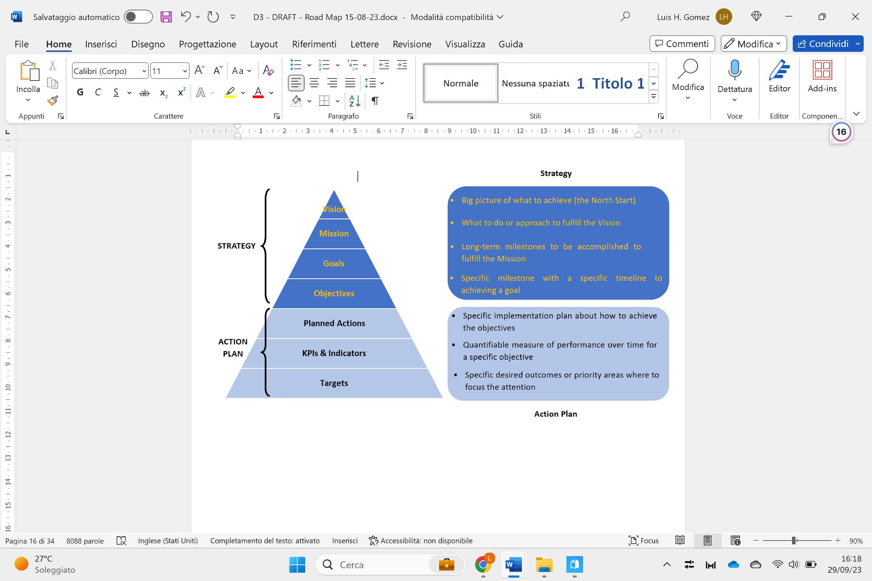
Conceptual & Methodological Approach
A road map is a Strategic Plan that defines a desired outcome and includes the major steps or milestones needed to reach it.

Slide 11
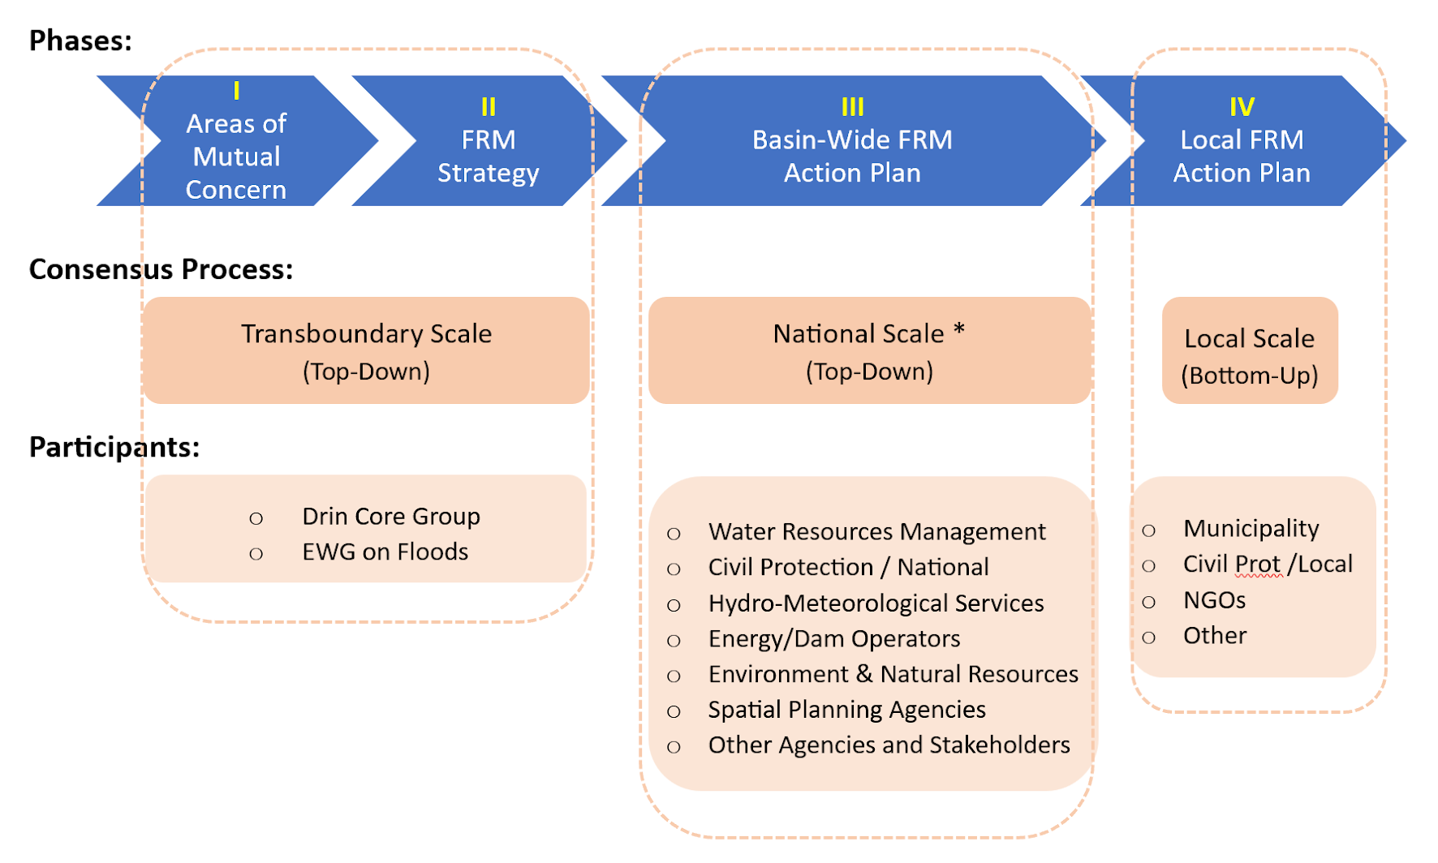
Draft Road Map – Operational Phases
  The FRM Plans will NOT replace National Flood Policies, but will take full account of them, together with all other national efforts/activities/projects related to flooding
  Coordination Between the Basin-Wide FRM Strategy, the National & Local Action Plans
  (Final Objective, Contribute to Optimize the Interventions in the Areas of Mutual Concern)

Slide 12
Road Map – Development of Drin Flood Risk Policies
Draft Road Map – Time Scheduling

Slide 13
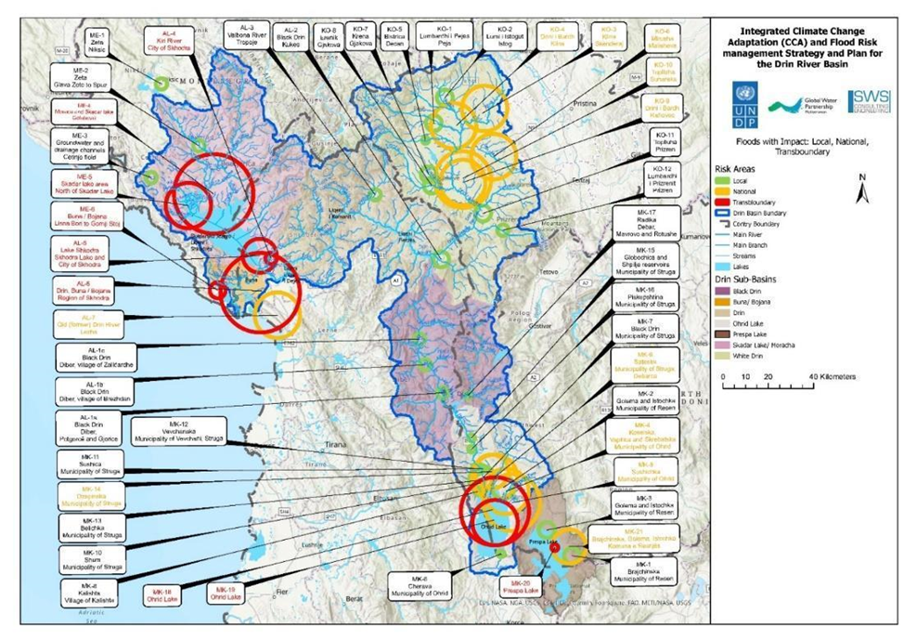
Road Map – Development of Drin Flood Risk Policies
Proposed Flood Risk Areas of Mutual Concern
  Classification of APSFRs According to the Scale of Impact: Transboundary, National, and Local
  (By Eng. Alban Doko and Eng. Dragana Milovanovic)*
  * Next Presentation

Slide 14
Some Remarks
The Road Map (RM) illustrated the main international principles and international agenda on Climate Resilience & International Development.
The RM highlighted the cross-cutting role of WATER as a common element interconnecting the 3 major global milestones (UN-FCCC Paris Agreement, UN-DRR Sendai Framework, UNDP SDGs), and how Water-Aware Policies (Flood Risk Management) can strengthen climate change mitigation & adaptation goals.
The RM stressed that FRM shall be based on an IFRM approach, integrating Land (Agriculture, Urban) and Water Resources Management (surface, groundwater, coastal).
The RM confirmed that where an international river basin extends beyond the boundaries of a Member State, the parties shall produce one single international FRMP (Art. 8 EU FD)
As the project includes a Consensus & Stakeholders Engagement Process, an Executive Summary of the Road Map will be translated to the different riparian languages. The documents will be available at the Web-platform floods.drinbasin.org

Slide 15
Some Remarks
For Transboundary Drin FRM Strategy, the following Axes of Action are proposed:
  Prioritize Prevention & Preparedness FRM Measures
  Incentive NBS & No-Regret Climate Adaptation Measures
  Promote Equitable Transboundary Cooperation to Minimize Floodings and Bottom-Up Community Based Projects
The Road Map proposed a doble Top-Down & Bottom-Up methodological approach, the project was subdivided into 4 Operational Phases:
  Get Consensus on the Areas of Mutual Concern (Transboundary Level)
  Get Consensus on Transboundary FRM Strategy (Transboundary Level)
  Get Consensus on National FRM Plan (National Level)
  Get Consensus on the Local FRM Plan (Local, Pilot Municipalities)
The Road Map Proposed a Preliminary List of Flood Risk Areas of Mutual Concern to be discussed with the EWG (Next presentation)*

Slide 16
THANKS

